Slide 1



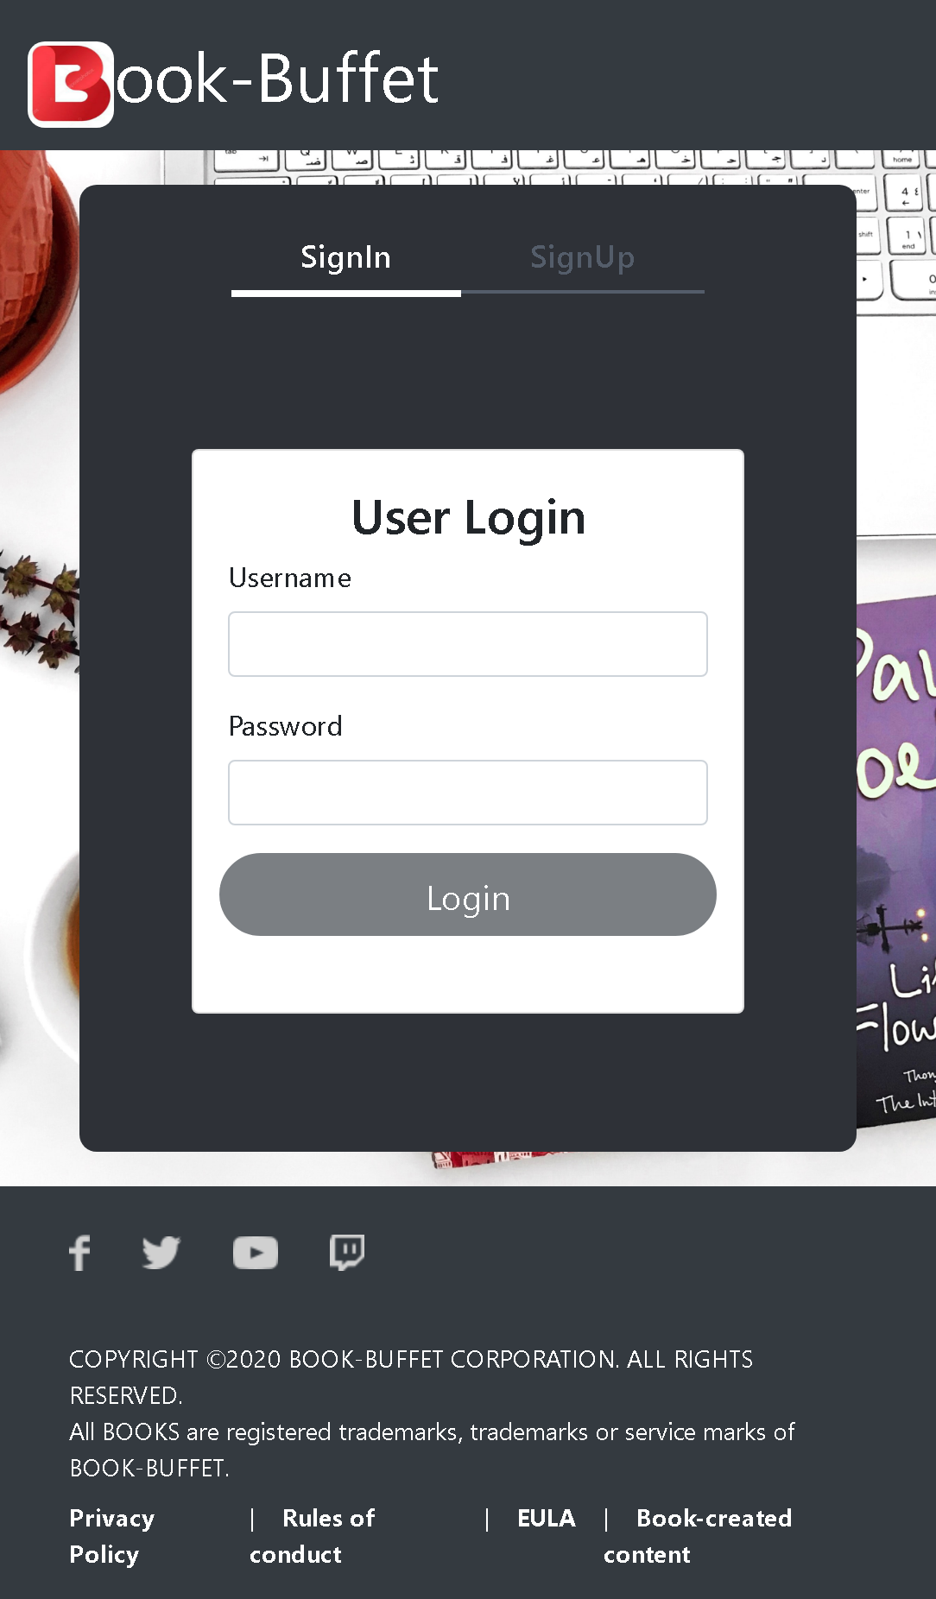
Shop-At-Home
Team 4: Vipul Prakash Nishant Kumar Manasa Kolipakula

Slide 2
Outline
Problem Statement
Objective
Microservices
Project Overview
Onboarding-Architecture
Project Flow
Technology and Tools Used
Conclusion

Slide 3

Problem Statement
E-commerce with shopping cart :
Users can log in once registration is done.
Users will select products and can check out with a cart with all products he/she is interested to buy.
Admin will add, delete and update the product

Slide 4
Objective :
Our objective is to provide best user experience to shop online with out stepping outside.

Slide 5
Microservices
User Registration service
Shopping Cart service
Catalog service
API Gateway
Eureka Server

Slide 6
Project Overview

Slide 7
Project Overview
User Registration Service
User Access
Client/Postman
API gateway
Feign Call
Catalogue Service
SQL
Server
Admin Access
Feign Call
User Access
Feign Call
Shopping Cart Service

Slide 8







Technologies and Tools Used

Slide 9
Project Flow

Slide 10
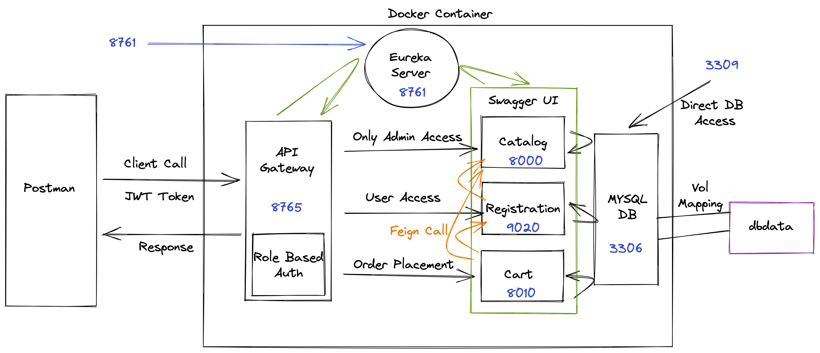
Project Flow :

Slide 11
Conclusion
The Shop- at-home app helps the user to shop products online. It also helps users to add the favourite items to the cart and view the cart.

Slide 12



Slide 13


Slide 14
Architecture
User Registration API
JWT validator
SQL Server
Login/Register
POST request
Token generated
Catalogue API
View/update/add
GET/POST
SQL Server
Front End
Postman
GET/POST
GET/POST
Shopping Cart API
Add/view to Cart
SQL Server
GET/POST

